Slide 1

Your
Brand Launch Info guide
Vendors, Please fill out the following slides for Chex to have all relevant information needed for your brand launch.
Please fill out slide 3 using the questions prompted on slide 2.
Please fill in slide 4 with relevant information prompted in the
text boxes.
Refer to slide 5 as an example of what a finished slide looks like.
Thank you!

Slide 2
Your
Brand Launch Info guide
ITEM NAME(S) and UPC(S): Note to vendor – this should only include skus that Chex has accepted
Item 1 – UPC xxxx
Item 2 – UPC xxxx
Item 3 – UPC xxxx
Talking Points: Please include any relevant information below that would be useful for Chex to know when discussing your brand/products
Brand Background: How and when did company start? What inspired the brand? Please provide a general overview of who you are and what you do
What makes your brand/product stand out? What makes product unique to the market and to Chex?
Any product specific info? Example: product is made with a certain ingredient, product is gluten-free” etc.
Are there any exclusive claims? Example: “You can only find this product at Chex” or “This is the only brand to do ___,” or “This olive oil is limited edition only; there are only 10,000 bottles made each year, and Chex has claimed 8,000 of them.”
Why are you passionate about your brand?
Has your brand/product been featured in any publications, news articles, etc?
Please list social media links for the following if applicable: Instagram, Facebook, LinkedIn
Please send video content if applicable
How/ Where should we merchandise product?

Slide 3
Your
Your Brand Here
ITEM NAME(S) and UPC(S): Note to vendor – this should only include skus that Chex has accepted
Item 1 – UPC xxxx
Item 2 – UPC xxxx
Item 3 – UPC xxxx
Talking Points: Please include any relevant information below that would be useful for Chex to know when discussing your brand/products
X
X
X
X
X
X
X
X
X

Slide 4
Chex Category
Your
Brand Name
Brand story-
Minimum of 100 words
500-character limit
Your Logo
Product image
Product image
Product image
Check list of product attributes/ selling points
Product Image/ Images
Images should be a pure white background, PNG format preferred, but jpeg is acceptable.
Please also send high-res image of each product to marketing@chexfoods.com
Lifestyle image (if applicable)
Product/ Brand Certifications
Social Media QR code
Item Grid (Chex will fill in)
Vendor: Please leave room for grid on bottom of slide

Slide 5

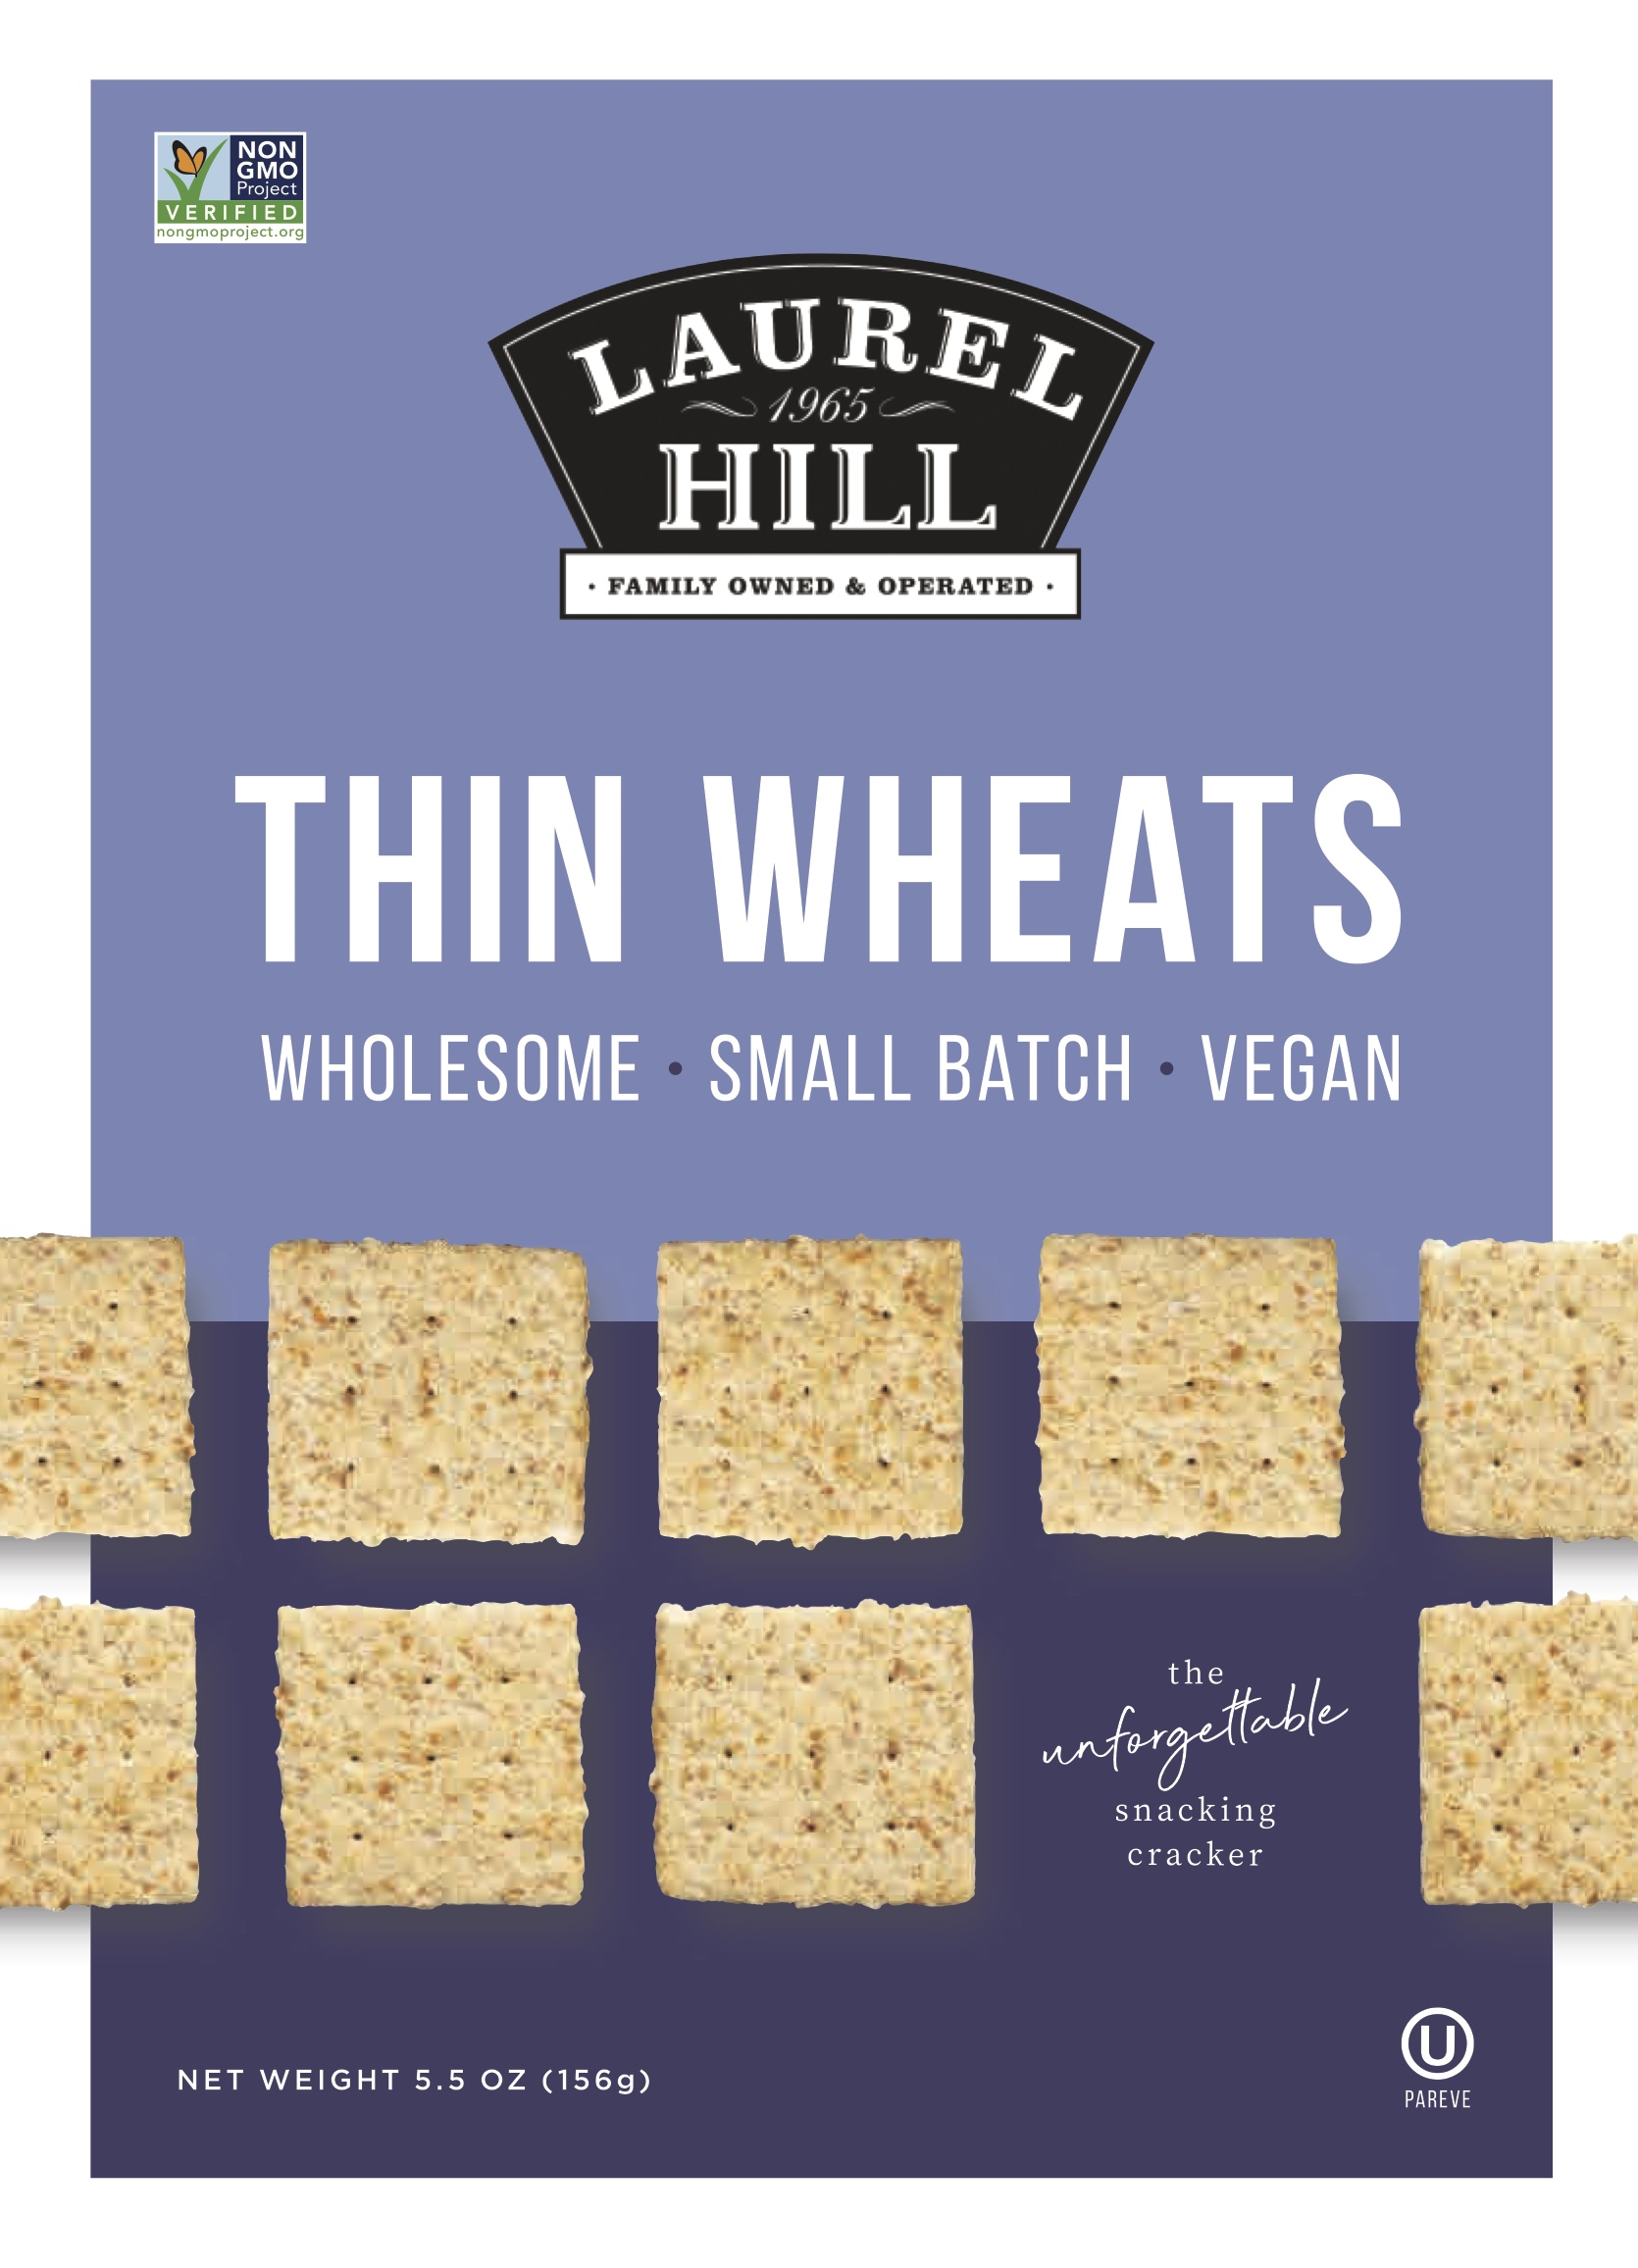
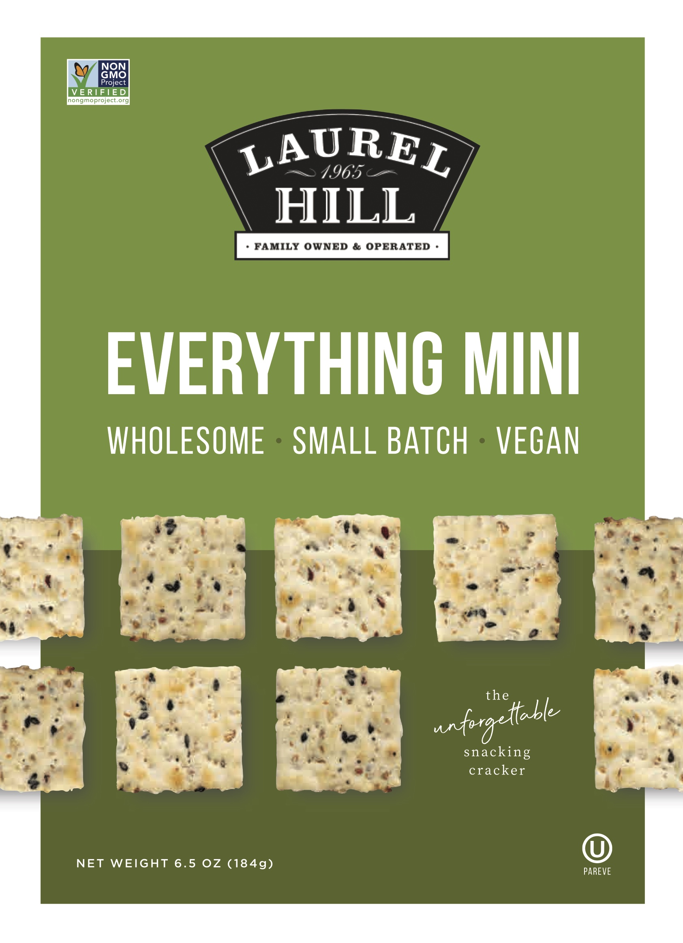
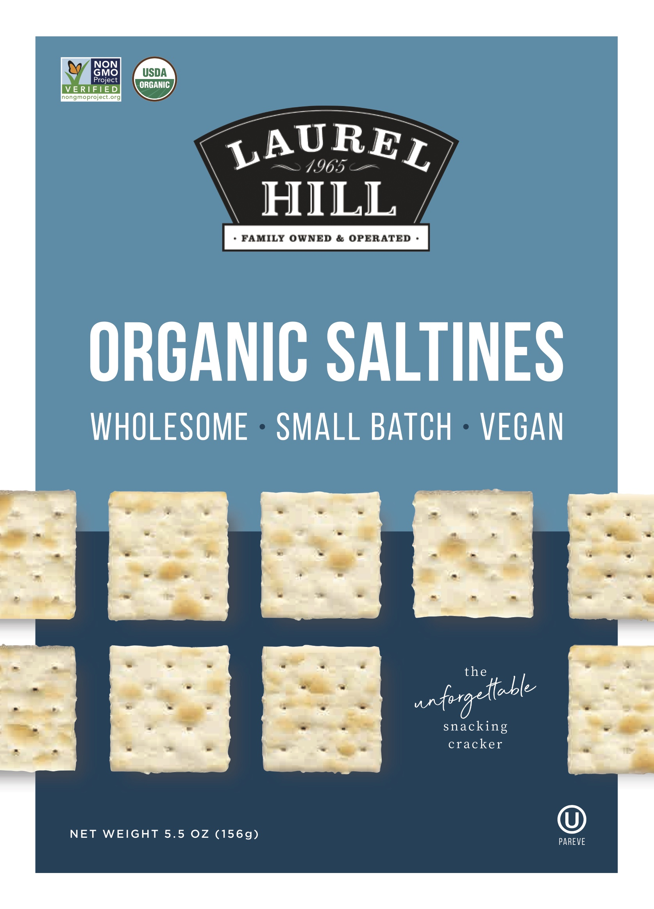

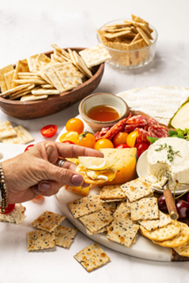

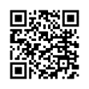


Crackers & Breads
Laurel Hill
Example
Since 1965, we have been providing our Laurel Hill products to leading retailers throughout the Northeast. Today, over 50 years later, Laurel Hill has continued to expand our product selections and we now supply our Laurel Hill products to passionate food lovers around the country.
Made locally in Massachusetts
Familiar flavors- perfect snack any time of day
Vegan
Non-GMO
EXCLUSIVE to Chex!

